Slide 1
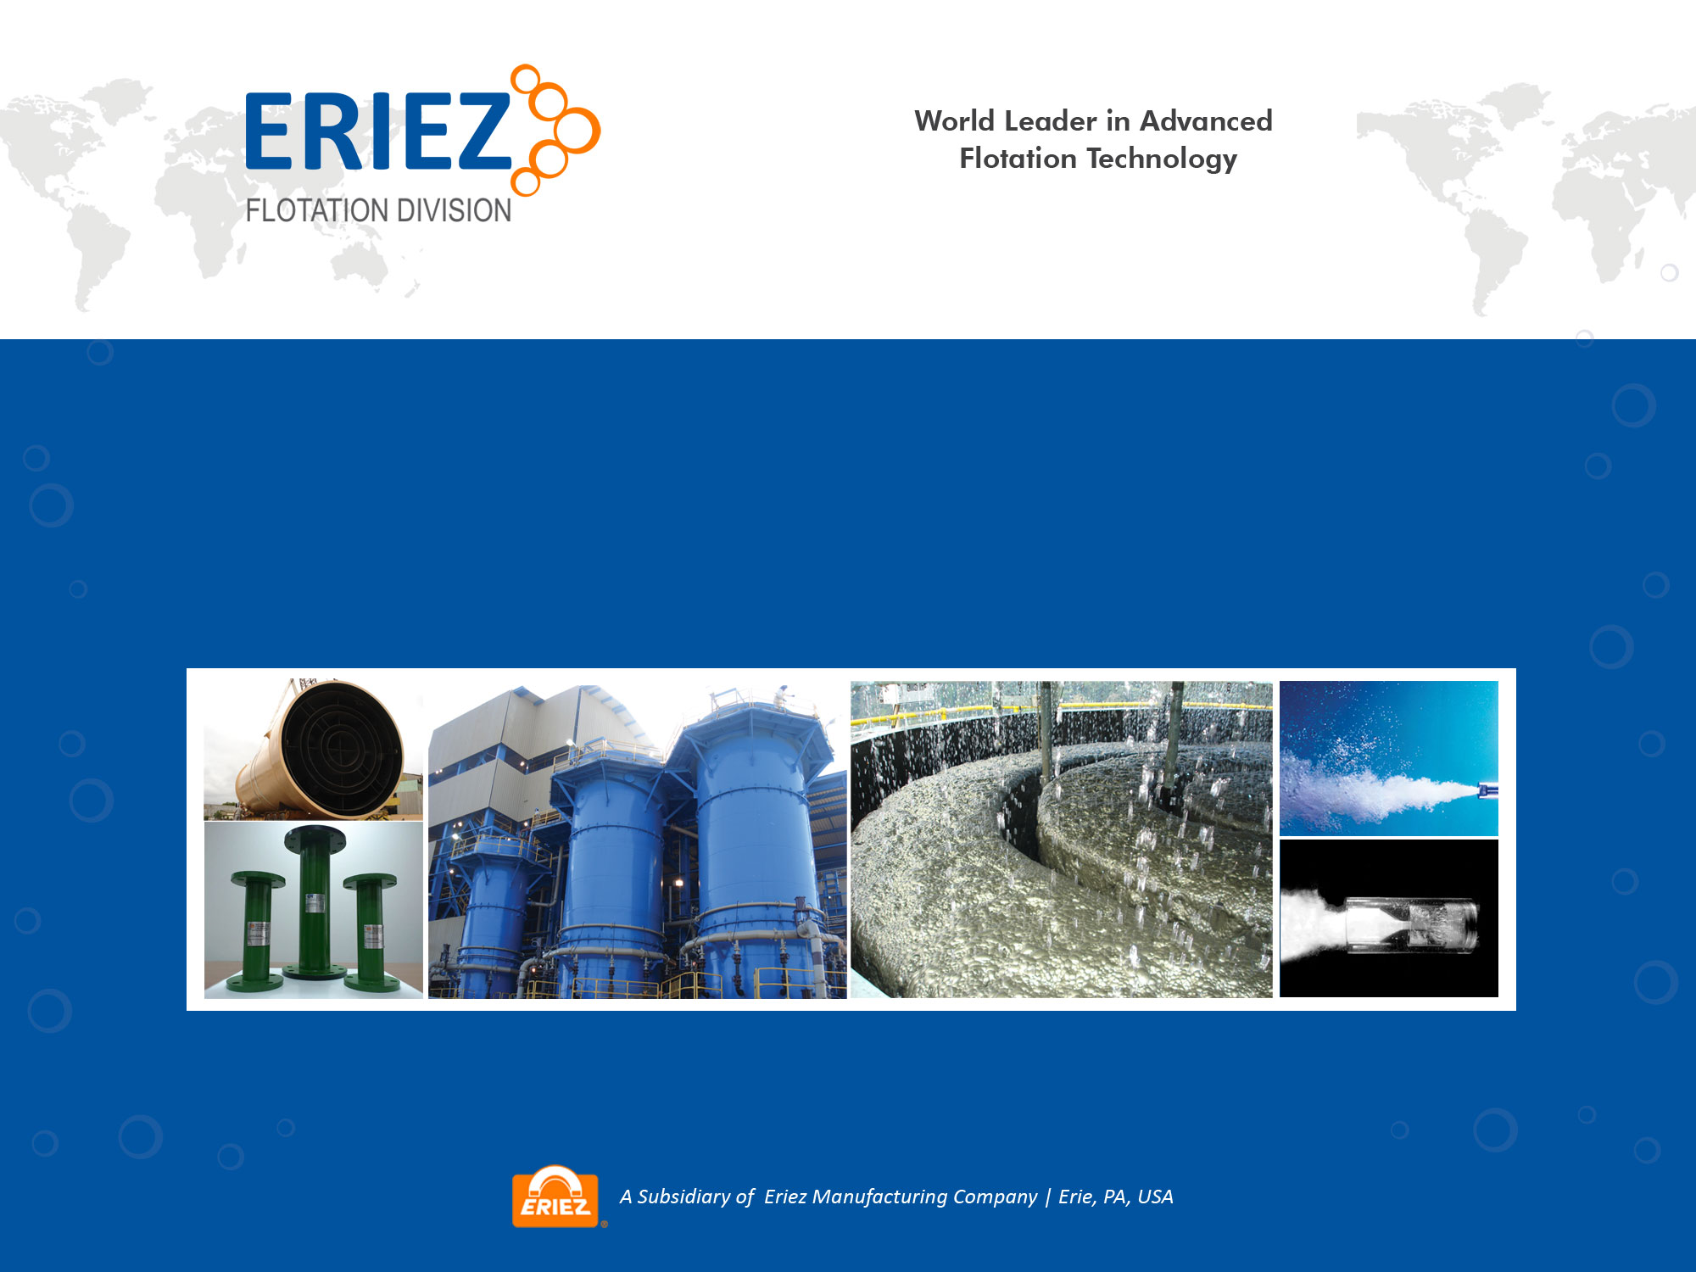
Case Study: Sacle-up of an EFD Flotation Column for Copper Cleaning
Updated Nov 2016

Slide 2
Outline
Background: Sandfire’s DeGrussa Copper
Technical challenge with flow-sheet
Eriez’ CavTube™ Sparged Column
On-site test-work
Results and conclusions

Slide 3
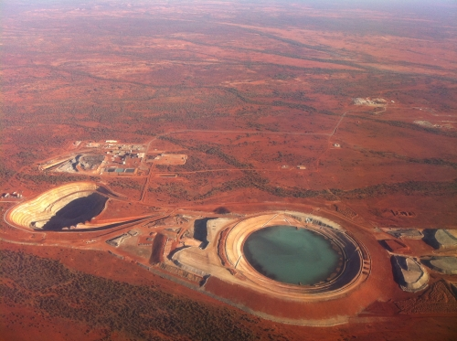
Sandfire’s DeGrussa Copper
Located in WA
High-grade copper-gold sulfide mine
1.5 Mtpa concentrator commenced commercial production Sep 2012.
Production up to 300,000 tonnes of high grade copper concentrate annually.

Slide 4
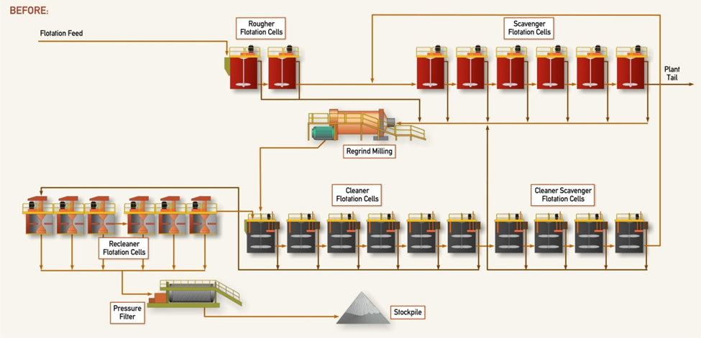
Concentrator Flowsheet-circa 2014
2 Ro – TC50
6 Scavs – TC50
6 Cl - TC30
4 Cl Scavs TC30
6 2nd Cl OK16U
Notes:
-All mechanical flotation circuit
-Feed is massive sulfide about 5% copper and p80 of about 40 microns
-concentrate from roughers and scavengers feeds a regrind circuit
-Regrind to a p80 ~ 20 microns. Cleaner, second cleaner and cleaner scavenger
-Cleaner scavenger is recycled to the main scavengers

Slide 5
Challenges with original flowsheet
All mechanical flotation cell circuit
Rougher/scavenger recovery typically 91% with most losses < 7 μm & >75 μm
Not able to meet the cleaner flotation requirements of the plant (re-grind P₈₀ ~18 μm) because of poor selectivity at fine size
Heavily loaded and sticky froth on the recleaner cells leads to poor concentrate grade, high NSG on the final copper concentrate grade from hydraulic entrainment.
Significant circulating load required from cleaner scavenger cells back to rougher scavengers to enhance overall recoveries

Slide 6
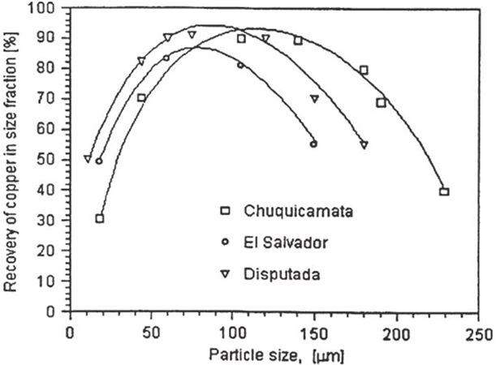
Limitations of conventional flotation
Flotation recovery by size for copper
Notes:
This slide shows recovery by size for copper flotation. You can see that there is a passband where performance is good. Performance at either end drops off dramatically, for different scientific reasons.
-Eriez has developed proprietary unit operations for each of these extremes, today we will focus on optimized flotation for fines

Slide 7
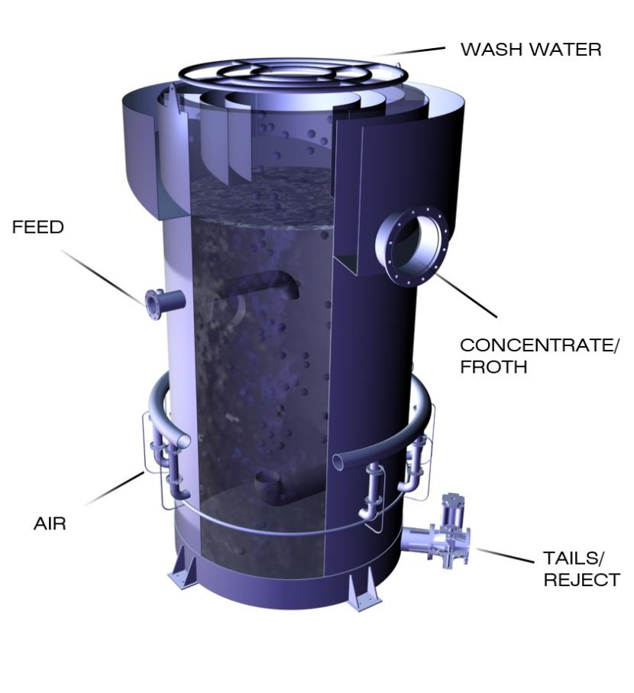
Column Technology
Tall Tanks w/High Aspect Ratio, counter-current contacting
Operate with Deep Froth
Incorporates Uniform Froth Washing -better selectivity
Low radial mixing, behaves more like PFR
Sparging System
  Heart of the Device
  Produces High Surface Area Rates of Air for Collection of Hydrophobic Species.
Notes:
-The left hand section is a cutaway of a column
-Feed comes in near the top, and settles downward
-Engineered high surface area bubbles enter near the bottom and rise up
-This illustration is not quote correct, in both cases the slurry feed and bubble feed are fed evenly across the cross-section with a manifold
-A collection zone with highly efficient mixing
-A deep controlled froth and counter current washing
-Read everything on the right hand side
-I am now going to spend some time talking about two key features of columns that were beneficial for this application; froth washing and cavitation sparging

Slide 8
Column Technology: Importance of wash water
Contaminant (tph)
Entrainment
Attachment
AIR
Entrapment
Froth
Locked
Entrainment
Feed
AIR
Tails
AIR
Froth Moisture (%)
VALUABLE
MIDDLING
WASTE
Notes:
-The cartoon on the LHS shows a cross-section through the froth. Of course liberated hydrophobic particles are attracted to the interface, the edge of the froth strut. But fine hydrophilic particles (ie with a good affinity for the water) will stay suspended in the water by Brownian forces and accompany the froth into the concentrate
-The graph on the LHS shows that fine hydrophilic contaminants reporting to the concentrate will be roughly proportional to the moisture in the froth

Slide 9
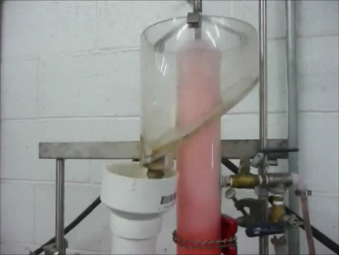
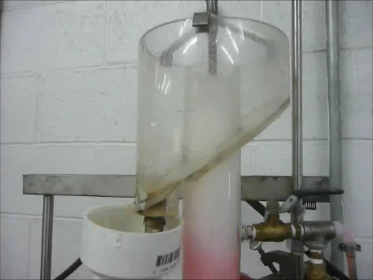
Column Technology: Importance of wash water
Notes:
-As an illustration of this, we have documented a simple experiment. We have added red dye to a column of water to simulate water-borne impurities.
-On the top photograph, the dye has accompanied the water into the froth.
-On the bottom photograph, a counter current flow of wash water has been added, which essentially displaces the froth water and pushes the impurity back into the pulp

Slide 10
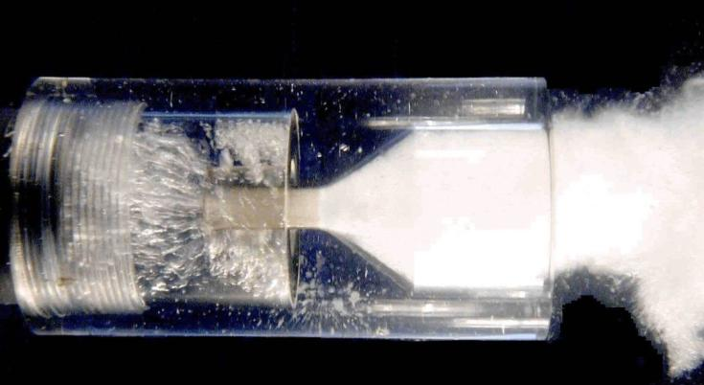
Making smaller bubbles- the CavTube®
High P
Low P
Inlet
Outlet
Plexiglass model
Contraction/ expansion nozzle
Shatters sparged air into ~100 micron bubbles
As pressure drops, ~ 1 micron bubbles are nucleated from the liquid phase and adsorb onto hydrophobic surfaces
Notes:
-Now I am going to talk about the sparging system that is optimal for floating fine particles, the Eriez CavTube system
-In this system, slurry and air are pumped through a sudden contraction and expansion. During the expansion very fine bubbles come of out of liquid solution and nucleate onto hydrophobic surfaces, the ore particles

Slide 11
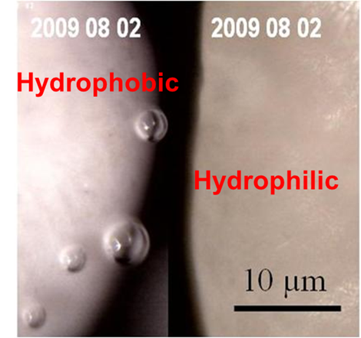
Bubble size distribution with air addition*
100
10
Cumulative curve Frother A
Cumulative curve Frother B
80
Population density Frother A
8
Population density Frother B
60
6
Cumulative Curve (%)
Population Density (%)
40
4
20
2
0
0
0.01
0.1
1
10
100
1000
Bubble Diameter (micrometer)
Note: for a typical application with Jg = 0.75 cm/sec, the nucleated bubbles are about 2% of total air volume added to cell
*Mining Sci. & Tech, 20 (2010), pp1-19
Notes:
-This slide shows continuous and cumulative bimodal bubble size distributions produced by the CavTube -The micrograph shows how the fine bubbles selectively adsorb onto hydrophobic surfaces. This kind of bubble nucleation has sometimes been referred to as a secondary collector.

Slide 12
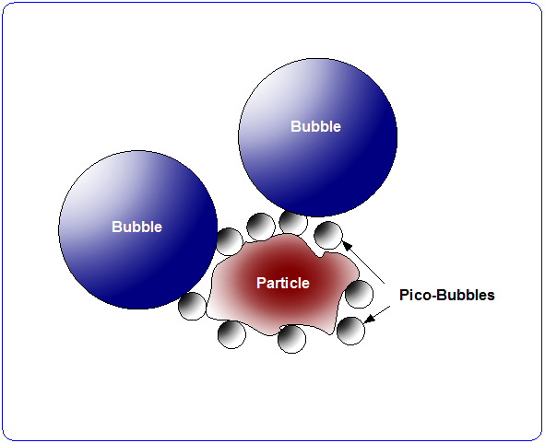
Probable mechanism for improved collection
Small bubbles preferentially nucleate on hydrophobic surfaces
Act to tether larger bubbles, ie improve sticking efficiency
Notes:
Our published paper references some academic work where they showed that when a surface was pre-treated with adsorbed microbubbles, the subsequent sticking probability with large bubbles was improved.

Slide 13
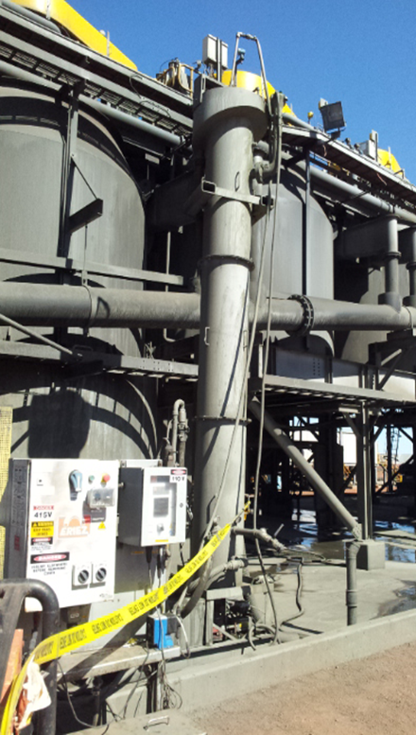
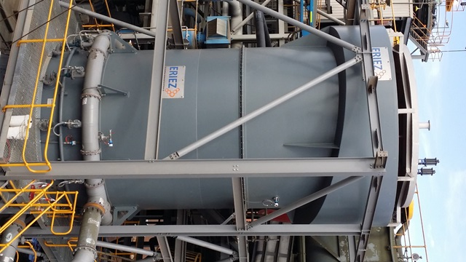
Evaluation of column and scale-up
500 mm pilot unit at site 4250 mm full-scale unit
EFD did on-site test-work at DeGrussa with a lab-scale column (150 mm dia) and then a pilot-scale column (500 mm dia)

Slide 14
Results
Result of commercial column exceed pilot results!

Slide 15
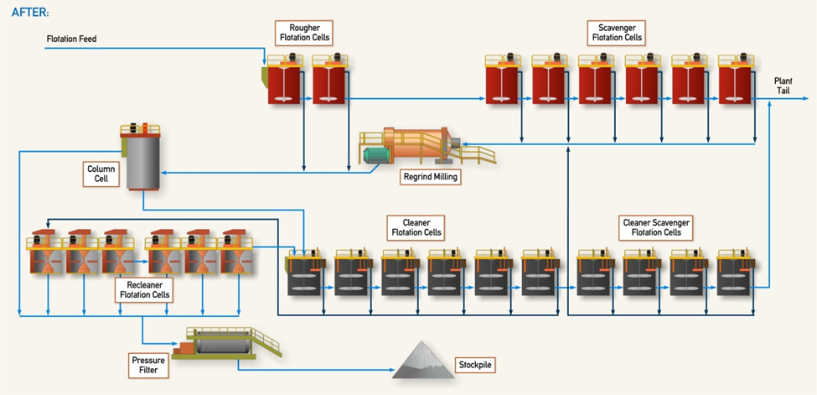
Concentrator Flowsheet-circa 2015
x
x
Notes:
-This is the new flowsheet, since January of last year.
-Because of the improvements in plant performance, the rougher concentrate does not need to be re-ground and can bypass the regrind mill
-Also the cleaner scavenger tail is sufficiently barren that it does not need to be recirculated to the scavenger feed
-And overall, plant recovery was greatly improved, as shown on the next slide.

Slide 16
Comparison: before and after
Circuit | Pre-Column Installation Survey 1 (2014) | Pre-Column Installation Survey 2 (2014) | Post Column Installation (2015)
Total Circuit Cu Recovery (%) | 89.8 | 87.4 | 91.7
Cleaner Block Cu Recovery (%) | 80 | 67 | 98.5
Column Cu Recovery (%) |  |  | 64.2
Recleaner Cu Recovery (%) | 85 | 82 | 53.3
  Circulating load from cleaner back to scavenger eliminated
  4 out of 6 mechanical recleaner cells were taken offline.
  Significant improvement in global copper recovery 2-4%

Slide 17
Conclusions
Conventional flotation cells are not optimal for all applications, especially with fine particles and fine gangue, similar result discovered at Cerro Corona (see Diaz et al, Flotation 2015)
Scale-up of columns is possible and Lab/ pilot results can be met or exceeded in commercial operation.
Comments from Sandfire management one month after commissioning the column “The column flotation cell in particular has delivered some positive early results, suggesting that the original recovery improvement target of about 1% may be exceeded.” (Sandfire CEO Karl Simich, Mining News Feb 26, 2015)
DeGrussa now doing test-work to add another column

